Slide 1
TOPIC 1.3 – MODULATION- BENEFITS

Slide 2

OBJECTIVES
To understand the meaning of Modulation
To know the important of Modulation
To learn the need for Modulation
To introduce various kinds of Modulation techniques

Slide 3
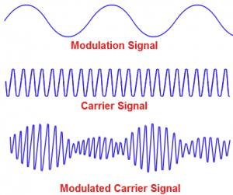
MODULATION
Modulate = Regulate
The process of regulating is modulation
One physical quantity is changing in accordance with another physical quantity.
Carrier signal is changing with message
signal in electrical communication.

Slide 4
THE ROLE OF MODULATION
How can we communicate with people from distant places?
We need something which will carry our message to desire place(carrier signal).
Modulation can only do the process to take carrier signal with our message signal.
Without modulation, our message signal will not be received by
destination.

Slide 5
NEED FOR MODULATION
The main reason is the disturbance of noise.
After transmitting, our message signal can be attacked by unwanted signals in the channel.
Message signal can be modified into unwanted signal by noise.
Because of noise, modulation must be done before transmitting.

Slide 6

NEED FOR MODULATION
Factors that suggest need of modulation
1. Practicable Size of Antenna
Speech and music signal(20Hz – 20kHz) can only travel for a few distance.
To receive the transmitted signal, the length of antenna should be a quarter-wavelength of the frequency used.
If frequency is 20kHz, wavelength will be 15km and the height of antenna will become 3.75km which is impossible to install.

Slide 7
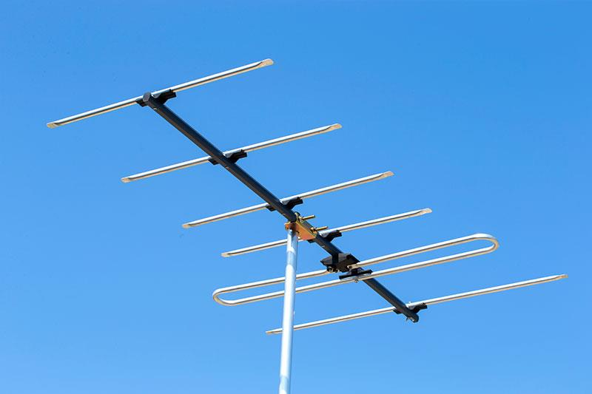
NEED FOR MODULATION
When we add high frequency signal(10MHz) with our message signal, frequency becomes high(10.02MHz).
Then the wavelength will low(30m) and the height of antenna will become practicable(7.5m).

Slide 8
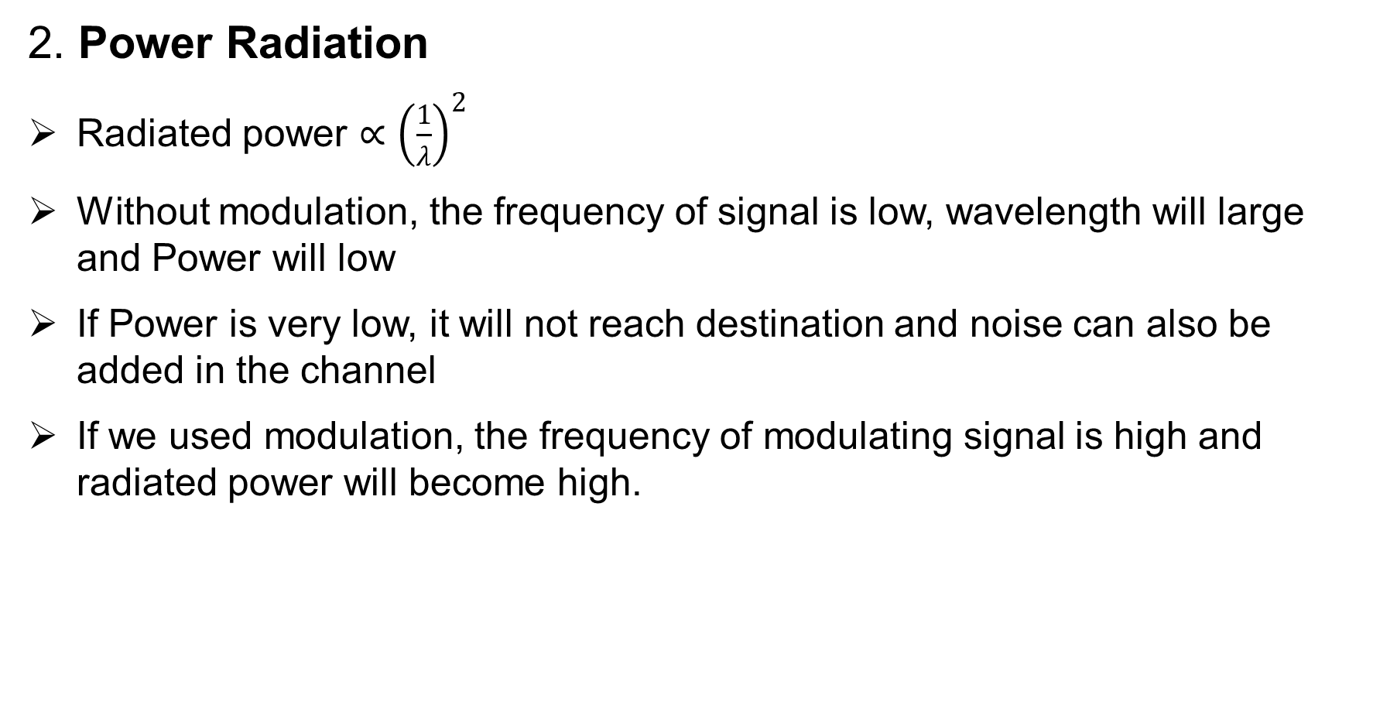
NEED FOR MODULATION

Slide 9
NEED FOR MODULATION
3. Narrow banding
Narrow banding does not mean that reducing the bandwidth.
Bandwidth will remain same
It means that making wavelength same
Example: We calculated the height of antenna based on wavelength. Without modulation, each frequency will need antenna to communicate.
If we use modulation, the wavelengths of many signals will be the same(not exactly)
By using modulation, antenna size requirement becomes same.

Slide 10
NEED FOR MODULATION
4. Common Processing
How if we have only one transmitter to control or use various signal transmitting
5. Multiplexing
Multiplexing is the process of sending several signals through a common channel.
Most of the television channels use the same frequency range(bandwidth).
How multiple signals go without overlapping each other?

Slide 11
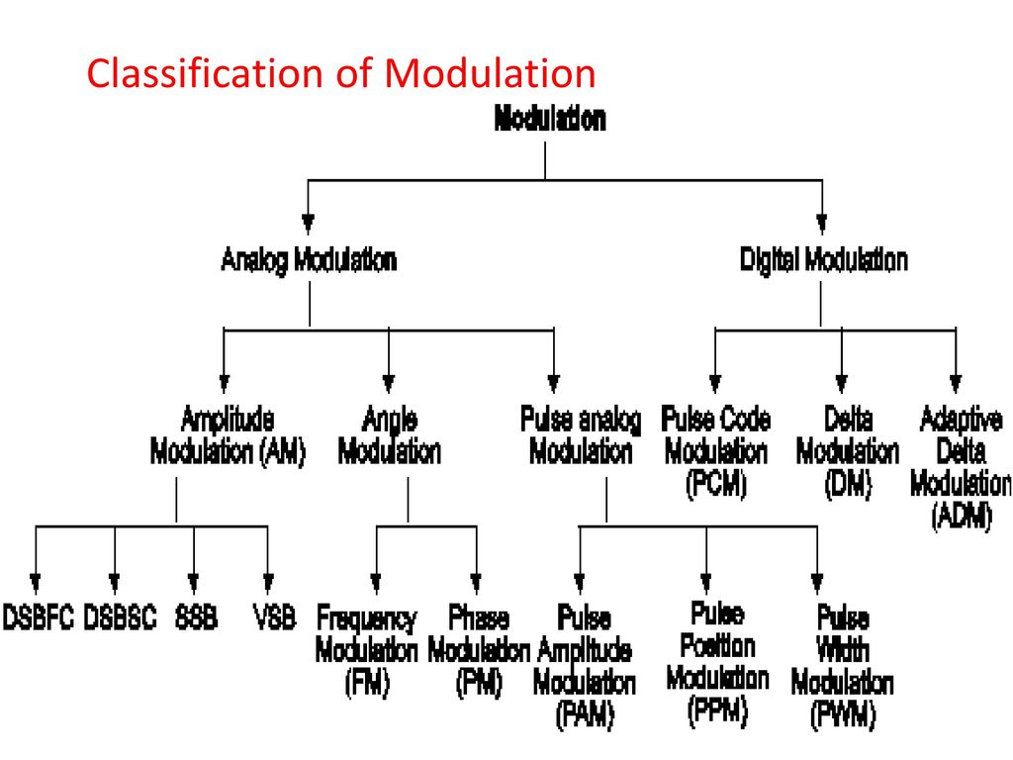

Slide 12
DIFFERENT TYPES OF MODULATION TECHNIQUES
Analog and Digital modulations.
In analog modulation, carrier is analog signal(continuous signal)
Base on the instantaneous value of message signal, amplitude, frequency and phase of carrier signal will change. 1. Amplitude modulation(AM) 2. Frequency modulation(FM) 3. Phase modulation(PM)

Slide 13
DIFFERENT TYPES OF MODULATION TECHNIQUES
In digital modulation, the carrier signal is digital signal(train of pulses)
Base on the instantaneous value of message signal, amplitude, frequency and phase of carrier signal will change. 1. Amplitude shift keying(ASK) 2. Frequency shift keying(FSK) 3. Phase shift keying(PSK)

Slide 14
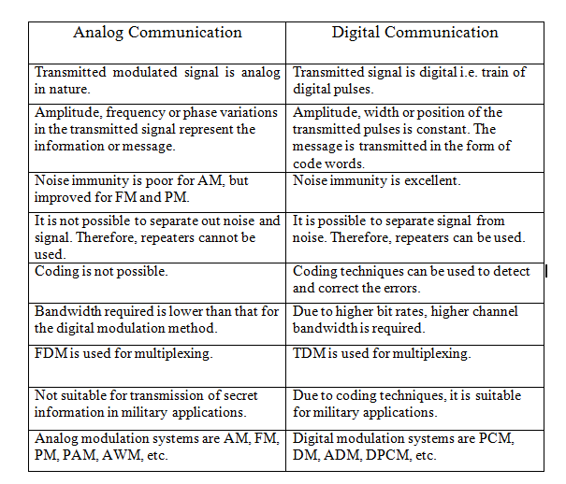
ANALOG & DIGITAL COMMUNICATIONS

Slide 15
THANK YOU

